Slide 1

Entrepreneurship: Successfully Launching New Ventures
Sixth Edition
Chapter 8
Assessing a New Venture’s Financial Strength and Viability
Notes:
If this PowerPoint presentation contains mathematical equations, you may need to check that your computer has the following installed:
1) MathType Plugin
2) Math Player (free versions available)
3) NVDA Reader (free versions available)

Slide 2
Learning Objectives (1 of 2)
8.1 Learn about the importance of understanding the financial management of an entrepreneurial firm.
8.2 Identify the four main financial objectives of entrepreneurial firms.
8.3 Describe the process of financial management as used in entrepreneurial firms.
8.4 Explain the difference between historical and pro forma financial statements.
8.5 Describe the different historical financial statements and their purpose.

Slide 3
Learning Objectives (2 of 2)
8.6 Discuss the role of forecasts in projecting a firm’s future income and expenses.
8.7 Explain the purpose of pro forma financial statements.

Slide 4
Financial Management (1 of 2)
Financial Management
Financial management deals with two things: raising money and managing a company’s finances in a way that achieves the highest rate of return.
Chapter 10 focuses on raising money. This chapter focuses primarily on:
How a new venture tracks its financial progress through preparing, analyzing, and maintaining past financial statements.
How a new venture forecasts future income and expenses by preparing pro forma (or projected) financial statements.

Slide 5
Financial Management (2 of 2)
The financial management of a firm deals with questions such as the following on an ongoing basis:
How are we doing? Are we making or losing money?
How much cash do we have on hand?
Do we have enough cash to meet our short-term obligations?
How efficiently are we utilizing our assets?
How do our growth and net profits compare to those of our industry peers?
Where will the funds we need for capital improvements come from?
Are there ways we can partner with other firms to share risk and reduce the amount of cash we need?
Overall, are we in good shape financially?

Slide 6
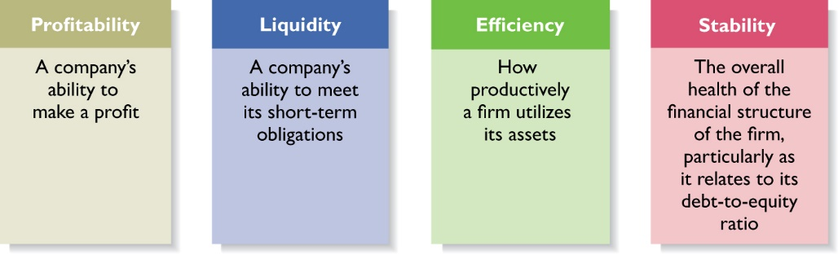
Financial Objectives of a Firm (1 of 3)
Figure 8.1 Primary Financial Objectives of Entrepreneurial Firms

Slide 7
Financial Objectives of a Firm (2 of 3)
Profitability
Is the ability to earn a profit.
Many start-ups are not profitable during their first one to three years while they are training employees and building their brands.
However, a firm must become profitable to remain viable and provide a return to its owners.
Liquidity
Is a company’s ability to meet its short-term financial obligations.
Even if a firm is profitable, it is often a challenge to keep enough money in the bank to meet its routine obligations in a timely manner.

Slide 8
Financial Objectives of a Firm (3 of 3)
Efficiency
Is how productively a firm utilizes its assets relative to its revenue and its profits.
Southwest Airlines, for example, uses its assets very productively. Its turnaround time, or the time its airplanes sit on the ground while they are being unloaded and reloaded, is the lowest in the airline industry.
Stability
Is the strength and vigor of the firm’s overall financial posture.
For a firm to be stable, it must not only earn a profit and remain liquid but also keep its debt in check.

Slide 9
The Process of Financial Management (1 of 4)
Importance of Financial Statements
To assess whether its financial objectives are being met, firms rely heavily on analysis of financial statements.
A financial statement is a written report that quantitatively describes a firm’s financial health.
The income statement, the balance sheet, and the statement of cash flows are the financial statements entrepreneurs use most commonly.
Forecasts
Are an estimate of a firm’s future income and expenses, based on past performance, its current circumstances, and its future plans.

Slide 10
The Process of Financial Management (2 of 4)
Forecasts (continued)
New ventures typically base their forecasts on an estimate of sales and then on industry averages or the experiences of similar start-ups regarding the cost of goods sold and other expenses.
Budgets
Are itemized forecasts of a company’s income, expenses, and capital needs and are also an important tool for financial planning and control.

Slide 11
The Process of Financial Management (3 of 4)
Financial Ratios
Depict relationships between items on a firm’s financial statements.
An analysis of its financial ratios helps a firm determine whether it is meeting its financial objectives and how it stacks up against industry peers.
Importance of Financial Management
Many experienced entrepreneurs stress the importance of keeping on top of the financial management of the firm.

Slide 12
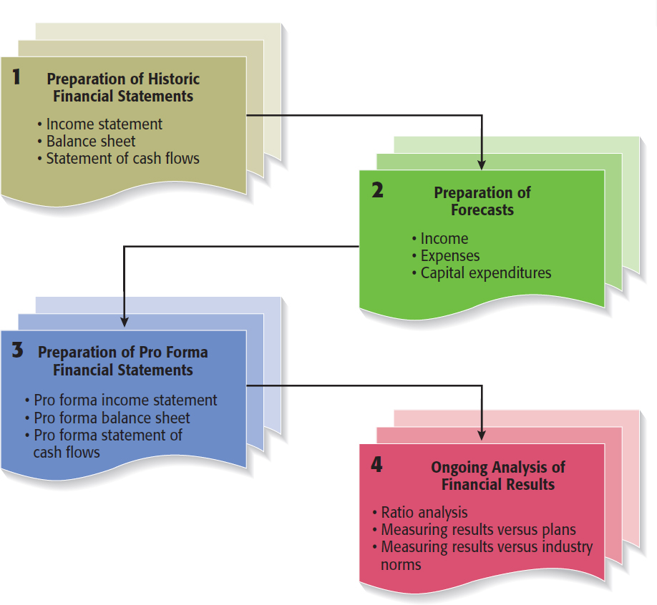
The Process of Financial Management (4 of 4)
Figure 8.2 The Process of Financial Management

Slide 13
Financial Statements
Historical Financial Statements
Reflect past performance and are usually prepared on a quarterly and annual basis.
Publicly traded firms are required by the SEC to prepare financial statements and make them available to the public.
Pro Forma Financial Statements
Are projections for future periods based on forecasts and are typically completed for two to three years in the future.
Pro forma financial statements are strictly planning tools and are not required by the SEC.

Slide 14
New Venture Fitness Drinks (1 of 2)
New Venture Fitness Drinks
To illustrate how financial statements are prepared, we used New Venture Fitness Drinks, the fictitious sports drink company introduced in Chapter 3.
New Venture Fitness Drinks has been in business for five years.
Targeting sports enthusiasts, the company sells a line of nutritional fitness drinks.
It opened a single location in 2016, added a second location in 2018, and plans to add a third in 2019.

Slide 15
New Venture Fitness Drinks (2 of 2)
New Venture Fitness Drinks (continued)
To illustrate how financial statements are prepared, we used New Venture Fitness Drinks, the fictitious sports drink company introduced in Chapter 3.
The company’s strategy is to place small restaurants, similar to smoothie restaurants, near large outdoor sports complexes.
The company is profitable and is growing at a rate of 25 percent per year.

Slide 16
Historical Financial Statements
Three types of historical financial statements
Financial Statement | Purpose
Income Statement | Reflects the results of the operations of a firm over a specified period of time. It records all the revenues and expenses for the given period and shows whether the firm is making a profit or is experiencing a loss.
Balance Sheet | Is a snapshot of a company’s assets, liabilities, and owner’s equity at a specific point in time.
Statement of cash flows | Summarizes the changes in a firm’s cash position for a specified period of time and details why the changes occurred.

Slide 17
Historical Income Statements
Table 8.1 Consolidated Income Statements for New Venture Fitness Drinks, Inc.
Blank | December 31, 2018 | December 31, 2017 | December 31, 2016
Net sales | $586,600 | $463,100 | $368,900
Cost of sales | 268,900 | 225,500 | 201,500
Gross profit | 317,700 | 237,600 | 167,400
Operating expenses | blank | blank | blank
Selling, general, and administrative expenses | 117,800 | 104,700 | 90,200
Depreciation | 13,500 | 5,900 | 5,100
Operating income | 186,400 | 127,000 | 72,100
Other income | blank | blank | blank
Interest income | 1,900 | 800 | 1,100
Interest expense | (15,000) | (6,900) | (6,400)
Other income (expense), net | 10,900 | (1,300) | 1,200
Income before income taxes | 184,200 | 119,600 | 68,000
Income tax expense | 53,200 | 36,600 | 18,000
Net income | 131,000 | 83,000 | 50,000
Earnings per share | 1.31 | 0.83 | 0.50

Slide 18
Historical Balance Sheets (1 of 2)
Assets
Table 8.2 Consolidated Balance Sheets for New Venture Fitness Drinks, Inc.
Assets | December 31, 2018 | December 31, 2017 | December 31, 2016
Current assets | Blank | Blank | Blank
Cash and cash equivalents | $63,800 | $54,600 | $56,500
Accounts receivable, less allowance for doubtful accounts | 39,600 | 48,900 | 50,200
Inventories | 19,200 | 20,400 | 21,400
Total current assets | 122,600 | 123,900 | 128,100
Property, plant, and equipment | Blank | Blank | Blank
Land | 260,000 | 160,000 | 160,000
Buildings and equipment | 412,000 | 261,500 | 149,000
Total property, plant, and equipment | 672,000 | 421,500 | 309,000
Less: accumulated depreciation | 65,000 | 51,500 | 45,600
Net property, plant, and equipment | 607,000 | 370,000 | 263,400
Total assets | 729,600 | 493,900 | 391,500

Slide 19
Historical Balance Sheets (2 of 2)
Liabilities and Shareholders’ Equity
Table 8.2 (continued)
Assets | December 31, 2018 | December 31, 2017 | December 31, 2016
Liabilities and shareholders’ equity Current liabilities | Blank | Blank | Blank
Accounts payable | 30,200 | 46,900 | 50,400
Accrued expenses | 9,900 | 8,000 | 4,100
Total current liabilities | 40,100 | 54,900 | 54,500
Long-term liabilities Long-term debt | 249,500 | 130,000 | 111,000
Long-term liabilities | 249,500 | 130,000 | 111,000
Total liabilities | 289,600 | 184,900 | 165,500
Shareholders’ equity | Blank | Blank | Blank
Common stock (100,000 shares) | 10,000 | 10,000 | 10,000
Retained earnings | 430,000 | 299,000 | 216,000
Total shareholders’ equity | 440,000 | 309,000 | 226,000
Total liabilities and shareholders’ equity | 729,600 | 493,900 | 391,500

Slide 20
Historical Statement of Cash Flows (1 of 2)
Table 8.3 Consolidated Statement of Cash Flows for New Venture Fitness Drinks, Inc.
Blank | December 31, 2018 | December 31, 2017
Cash flows from operating activities | Blank | Blank
Net income | $131,000 | $83,000
Additions (sources of cash) | Blank | Blank
Depreciation | 13,500 | 5,900
Decreases in accounts receivable | 9,300 | 1,300
Increase in accrued expenses | 1,900 | 3,900
Decrease in inventory | 1,200 | 1,000
Subtractions (uses of cash) | Blank | Blank
Decrease in accounts payable | (16,700) | (3,500)
Total adjustments | 9,200 | 8,600
Net cash provided by operating activities | 140,200 | 91,600
Cash flows from investing activities | Blank | Blank

Slide 21
Historical Statement of Cash Flows (2 of 2)
Table 8.3 (continued)
Blank | December 31, 2018 | December 31, 2017
Purchase of building and equipment | (250,500) | (112,500)
Net cash flows provided by investing activities | (250,500) | (112,500)
Cash flows from financing activities | Blank | Blank
Proceeds from increase in long-term debt | 119,500 | 19,000
Net cash flows provided by financing activities | 119,500 | 19,000
Increase in cash | 9,200 | (1,900)
Cash and cash equivalents at the beginning of each year | 54,600 | 56,500
Cash and cash equivalents at the end of each year | 63,800 | 54,600

Slide 22
Ratio Analysis (1 of 2)
Ratio Analysis
The most practical way to interpret or make sense of a firm’s historical financial statements is through ratio analysis, as shown in the next slide.
Comparing a Firm’s Financial Results to Industry Norms
Comparing a firm’s financial results to industry norms helps a firm determine how it stacks up against its competitors and if there are any financial “red flags” requiring attention.

Slide 23
Historical Ratio Analysis (1 of 2)
Table 8.4 Ratio Analysis for New Venture Fitness Drinks, Inc.
Ratio | Formula | 2018 | 2017 | 2016
Profitability ratios: associate the amount of income earned with the resources used to generate it | Blank | Blank | Blank | Blank
Return on assets | ROA = net income/average total assetsª | 21.4% | 18.7% | 14.7%
Return on equity | ROE = net income/average shareholders’ equity^{b} | 35.0% | 31.0% | 24.9%
Profit margin | Profit margin = net income/net sales | 22.3% | 17.9% | 13.6%
Liquidity ratios: measure the extent to which a company can quickly liquidate assets to cover short-term liabilities | Blank | Blank | Blank | Blank
Current | Current assets/current liabilities | 3.06 | 2.26 | 2.35
Quick | Quick assets/current liabilities | 2.58 | 1.89 | 1.96

Slide 24
Historical Ratio Analysis (2 of 2)
Table 8.4 (continued)
Ratio | Formula | 2018 | 2017 | 2016
Overall financial stability ratio: measures the overall financial stability of a firm | Blank | Blank | Blank | Blank
Debt | Total debt/total assets | 39.7% | 37.4% | 42.3%
Debt to equity | Total liabilities/owners’ equity | 65.8% | 59.8% | 73.2%
ª Average total assets = beginning total assets + ending total assets ÷ 2.
^{b} Average shareholders’ equity = beginning shareholders’ equity + ending shareholders’ equity ÷ 2.

Slide 25
Forecasts (1 of 4)
Forecasts
The analysis of a firm’s historical financial statements are followed by the preparation of forecasts.
Forecasts are predictions of a firm’s future sales, expenses, income, and capital expenditures.
A firm’s forecasts provide the basis for its pro forma financial statements.
A well-developed set of pro forma financial statements helps a firm create accurate budgets, build financial plans, and manage its finances in a proactive rather than a reactive manner.

Slide 26
Forecasts (2 of 4)
Sales Forecast
A sales forecast is a projection of a firm’s sales for a specified period (such as a year).
It is the first forecast developed and is the basis for most of the other forecasts.
A sales forecast for a new firm is based on a good-faith estimate of sales and on industry averages or the experiences of similar start-ups.
A sales forecast for an existing firm is based on (1) its record of past sales, (2) its current production capacity and product demand, and (3) any factors that will affect its future production capacity and product demand.

Slide 27
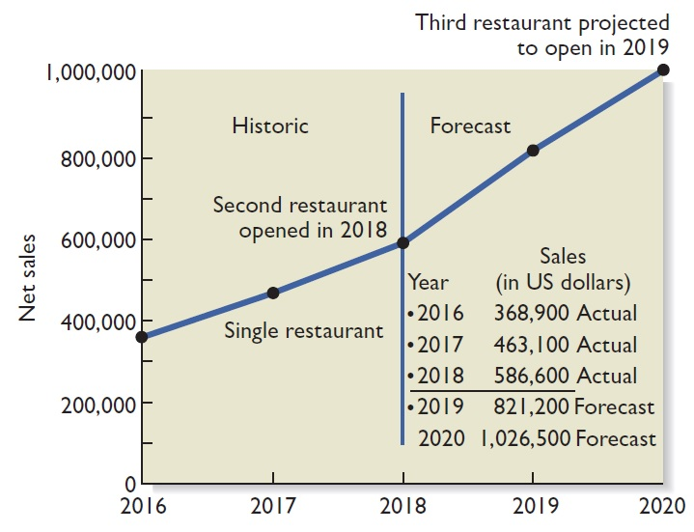
Forecasts (3 of 4)
Figure 8.3 Historical and Forecasted Annual Sales for New Venture Fitness Drinks
Insert new Figure 8.3

Slide 28
Forecasts (4 of 4)
Forecast of Costs of Sales and Other Items
Once a firm has completed its sales forecast, it must forecast its cost of sales (or cost of goods sold) and the other items on its income statement.
The most common way to do this is to use the percent-of-sales method, which is a method for expressing each expense item as a percentage of sales.
If a firm determines that it can use the percent-of-sales method and it follows the procedures described in the textbook, then the net result is that each expense item on its income statement will grow at the same rate as sales (with the exception of items that can be individually forecast, such as depreciation).

Slide 29
Pro Forma Financial Statements
Pro Forma Financial Statements
A firm’s pro forma financial statements are similar to its historical financial statements except that they look forward rather than track the past.
The preparation of pro forma financial statements helps a firm rethink its strategies and make adjustments if necessary.
The preparation of pro forma financials is also necessary if a firm is seeking funding or financing.

Slide 30
Types of Pro Forma Financial Statements
Financial Statement | Purpose
Pro Forma Income Statement | Shows the projected financial results of the operations of a firm over a specific period.
Pro Forma Balance Sheet | Shows a projected snapshot of a company’s assets, liabilities, and owner’s equity at a specific point in time.
Pro Forma Statement of Cash flows | Shows the projected flow of cash into and out of a company for a specific period.

Slide 31
Pro Forma Income Statements
Table 8.6 Pro Forma Income Statement for New Venture Fitness Drinks, Inc.
blank | 2018 Actual | 2017 Projected | 2016 Projected
Net sales | $586,600 | $821,200 | $1,026,500
Cost of sales | 268,900 | 390,000 | 487,600
Gross profit | 317,700 | 431,200 | 538,900
Operating expenses | blank | blank | blank
Selling, general, and administrative expenses | 117,800 | 205,300 | 256,600
Depreciation | 13,500 | 18,500 | 22,500
Operating income | 186,400 | 207,400 | 259,800
Other income | blank | blank | blank
Interest income | 1,900 | 2,000 | 2,000
Interest expense | (15,000) | (17,500) | (17,000)
Other income (expense), net | 10,900 | 20,000 | 20,000
Income before income taxes | 184,200 | 211,900 | 264,800
Income tax expense | 53,200 | 63,600 | 79,400
Net income | 131,000 | 148,300 | 185,400
Earnings per share | 1.31 | 1.48 | 1.85

Slide 32
Pro Forma Balance Sheets (1 of 2)
Assets
Table 8.7 Pro Forma Balance Sheets for New Venture Fitness Drinks, Inc.
Assets | December 31, 2018 | Projected 2019 | Projected 2020
Current assets | blank | blank | blank
Cash and cash equivalents | $63,800 | $53,400 | $80,200
Accounts receivable, less allowance for doubtful accounts | 39,600 | 57,500 | 71,900
Inventories | 19,200 | 32,900 | 41,000
Total current assets | 122,600 | 143,800 | 193,100
Property, plant, and equipment | blank | blank | blank
Land | 260,000 | 260,000 | 360,000
Buildings and equipment | 412,000 | 512,000 | 687,000
Total property, plant, and equipment | 672,000 | 772,000 | 1,047,000
Less: accumulated depreciation | 65,000 | 83,500 | 106,000
Net property, plant, and equipment | 607,000 | 688,500 | 941,000
Total assets | 729,600 | 832,300 | 1,134,100

Slide 33
Pro Forma Balance Sheets (2 of 2)
Table 8.7 (continued)
Assets | December 31, 2018 | Projected 2019 | Projected 2020
Liabilities and shareholders’ equity | blank | blank | blank
Current liabilities | blank | blank | blank
Accounts payable | 30,200 | 57,500 | 71,900
Accrued expenses | 9,900 | 12,000 | 14,000
Total current liabilities | 40,100 | 69,500 | 85,900
Long-term liabilities | blank | blank | blank
Long-term debt | 249,500 | 174,500 | 274,500
Total long-term liabilities | 249,500 | 174,500 | 274,500
Total liabilities | 289,600 | 244,000 | 360,400
Shareholders’ equity | blank | blank | blank
Common stock (100,000 shares) | 10,000 | 10,000 | 10,000
Retained earnings | 430,000 | 578,300 | 763,700
Total shareholders’ equity | 440,000 | 588,300 | 773,700
Total liabilities and shareholders’ equity | 729,600 | 832,300 | 1,134,100

Slide 34
Pro Forma Statement of Cash Flows (1 of 2)
Operating Activities
Table 8.8 Pro Forma Statement of Cash Flows for New Venture Fitness Drinks, Inc.
blank | December 31, 2018 | Projected 2019 | Projected 2020
Cash flows from operating activities | blank | blank | blank
Net income | $131,000 | $148,300 | $185,400
Changes in working capital | blank | blank | blank
Depreciation | 13,500 | 18,500 | 22,500
Increase (decrease) in accounts receivable | 9,300 | (17,900) | (14,400)
Increase (decrease) in accrued expenses | 1,900 | 2,100 | 2,000
Increase (decrease) in inventory | 1,200 | (13,700) | (8,100)
Increase (decrease) in accounts payable | (16,700) | 27,300 | 14,400
Total adjustments | 9,200 | 16,300 | 16,400
Net cash provided by operating activities | 140,200 | 164,600 | 201,800

Slide 35
Pro Forma Statement of Cash Flows (2 of 2)
Investing Activities and Financing Activities
Table 8.8 (continued)
blank | December 31, 2018 | Projected 2019 | Projected 2020
Cash flows from investing activities | blank | blank | blank
Purchase of building and equipment | (250,500) | (100,000) | (275,000)
Net cash flows provided by investing activities | (250,500) | (100,000) | (275,000)
Cash flows from financing activities | blank | blank | blank
Proceeds from increase in long-term debt | 119,500 | – | 100,000
Principle reduction in long-term debt | blank | (75,000) | blank
Net cash flows provided by financing activities | blank | blank | blank
Increase in cash | 9,200 | (10,400) | 26,800
Cash and cash equivalents at the beginning of the year | 54,600 | 63,800 | 53,400
Cash and cash equivalents at the end of the year | 63,800 | 53,400 | 80,200

Slide 36
Ratio Analysis (2 of 2)
Ratio Analysis
The same financial ratios used to evaluate a firm’s historical financial statements should be used to evaluate the pro forma financial statements.
This work is completed so the firm can get a sense of how its projected financial performance compares to its past performance and how its projected activities will affect its cash position and its overall financial soundness.

Slide 37
Ratio Analysis Based on Historical and Pro-Forma Financial Statements
Table 8.9 Ratio Analysis of Historical and Pro Forma Financial Statements for New Venture Fitness Drinks, Inc.
Ratio | Historical 2016 | Historical 2017 | Historical 2018 | Projected 2019 | Projected 2020
Profitability ratios | Blank | Blank | Blank | Blank | Blank
Return on assets | 14.7% | 18.7% | 21.4% | 19.0% | 18.9%
Return on equity | 24.9% | 31.0% | 35.0% | 28.9% | 27.2%
Profit margin | 13.6% | 17.9% | 22.3% | 18.1% | 18.1%
Liquidity ratios | Blank | Blank | Blank | Blank | Blank
Current | 2.35 | 2.26 | 3.05 | 2.07 | 2.24
Quick | 1.96 | 1.89 | 2.58 | 1.60 | 1.78
Overall financial stability ratios | Blank | Blank | Blank | Blank | Blank
Debt | 42.3% | 37.4% | 39.7% | 29.3% | 31.8%
Debt to equity | 73.2% | 59.8% | 65.8% | 41.5% | 46.6%

Slide 38

Copyright

